Slide 1
Diversity in Maritime
Maritime Skills Commission
Diversity in Maritime Taskforce
Maritime Careers Taskforce

Slide 2
Diversity in Maritime Networks
Our networks are open, safe-space communities bringing together individuals, and allies, to be positive disruptors breaking down barriers to change.
Maritime Skills Commission

Slide 3
Diversity in Maritime Working Groups
Our working groups are smaller, focused groups who work in collaboration with the networks to deliver a range of diversity focused programmes and initiatives.
Maritime Skills Commission

Slide 4
Pledges
Women in Maritime
Mental Health in Maritime
Conference and Events Panel Pledge
Signing the Pledges are the first step to becoming a Diversity in Maritime Charter organisation.
Maritime Skills Commission

Slide 5
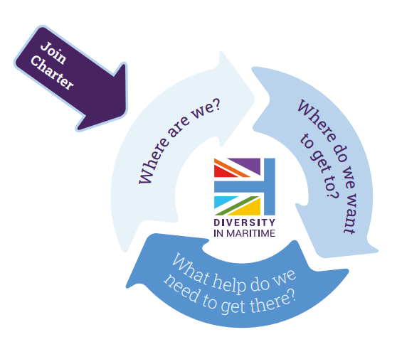
Charter
Maritime Skills Commission

Slide 6
Charter
Understand your baseline gender data and EDI commitments
Set your 5 -10yr targets
Create an action plan
Attend your panel session
Access to Charter roundtables, suite of toolkits and programmes
Maritime Skills Commission

Slide 7
Initiatives
Interview Pool
Speaker Bank
Toolkits
Ethnicity in Maritime Book Club
Regular network meetings
Regular webinars on a range of topics including menopause, organisational change, Black History Month, LGBT+ History Month, Creating a Culture of Care, public speaking..
Maritime Skills Commission

Slide 8
Roundtables during Shipping Week
Pride in Maritime Industry Roundtable: 13 September
Ethnicity in Maritime: 14 September
Women in.. Summit: 15 September
Mental Health in Maritime: 16 September
Diversity in Maritime Discussion: 17 September
Maritime Skills Commission

Slide 9
Upcoming network meetings
Mental Health Network: 22 September
Women’s Network: 6 October
Ethnicity Network: 12 October
Pride Network: 13 October
www.diversityinmaritime.uk
Maritime Skills Commission

