Slide 1
Port Marine Safety Code

Slide 2
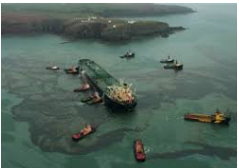
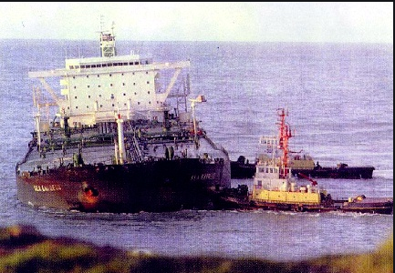
What is the Port Marine Safety Code and where did it come from
It’s a voluntary code of Practice introduced in 2002
It was created in response to the ‘Sea Empress’ disaster in February 1996 which resulted in a massive oil spill.
Although the code is voluntary it is regulated by the MCA and there is a requirement that all UK Statutory Harbour Authorities comply with the code.
The code is implemented through a formal Marine Safety Management System and Risk Management process.
The Code is intended to be flexible enough that any size or type of Harbour or marine facility will be able to apply its principles in a way that is appropriate and proportionate to local requirements

Slide 3
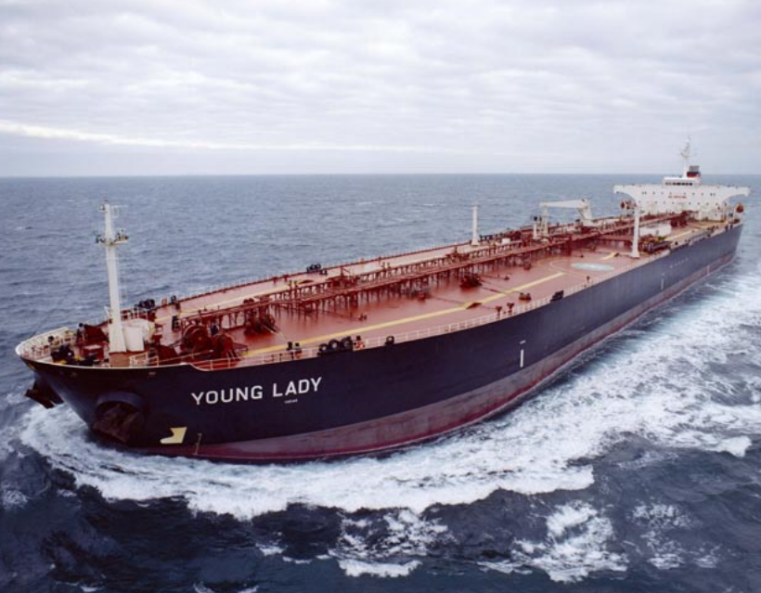
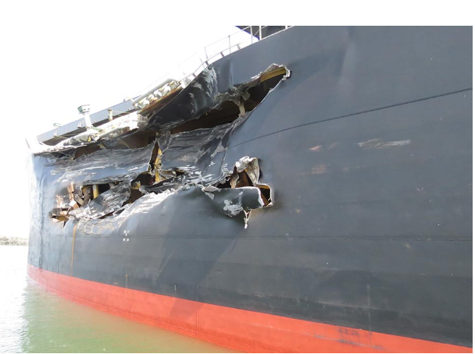
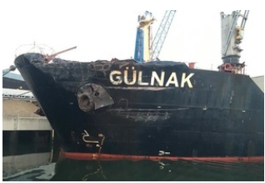
It Will Never Happen to Us.
Young Lady – Dragging anchor
snagging the CATS gas pipeline
25th June 2007
Wrong !!!
Gulnak / Cape Mathilde– Collision
18th April 2019
It Has & It Will.

Slide 4
WHO IS Code For?
The Code is applicable both to statutory harbour authorities and to other marine facilities which may not have statutory powers and duties. These are collectively referred to throughout the Code as ‘organisations’ and may include, but are not limited to, the following:
Competent Harbour Authorities (authorities with statutory pilotage duties);
Municipal Port or Harbour Authorities;
Trust Port or Harbour Authorities;
Private Port or Harbour Authorities;
and Marine berths, terminals or jetties.
What does it mean to me?
Where a marine terminal or jetty is situated within the jurisdiction of a Statutory Harbour Area (“SHA”), it is important for both parties to engage with one another to ascertain the scope and extent of the SHA’s MSMS and whether it incorporates any of the terminal’s or jetty’s marine operations. This engagement will help to define whether it is necessary for the terminal or jetty to develop their own MSMS. If it is decided that an additional system is required then the above engagement should focus on ensuring that the two MSMS complement each another and avoid any duplication of effort.
Failure to comply?
Failure to comply is not an offence in itself. However, the Code represents good practice as recognised by a wide range of industry stakeholders and a failure to adhere to good practice may be indicative of a harbour authority being in breach of certain legal duties. Moreover, the organisation may suffer reputational damage if it has publicly committed to the Code’s standards and then fails to meet them
.A successful prosecution has been brought against a harbour authority for breach of section 3 of the Health and Safety at Work Act 1974, in that non-compliance with the fundamental elements of the Code evidenced a failure to provide a safe system of work

Slide 5
MCA Role
The MCA is responsible to the Secretary of State for Transport in advising on the composition and application of this Code to all ports in the UK.
This includes but is not limited to:
the conducting of Health Checks ;
– monitoring the compliance of harbour authorities against the Code;
– the facilitation of regular meetings between port authorities, related to maritime industries operating within ports and government within the context of this Code in order to exchange opinions and developments which may have a bearing on the content of the Code and the way in which it is applied
– the production of an annual report highlighting emerging trends identified during health checks;
– other technical assistance which may be required by DfT.
Health Checks
A Health Check visit is intelligence led and may be triggered for a variety of reasons ranging from reports which suggests a failure in a port’s MSMS to a MAIB recommendation.
The main objective of a Health Check is to measure the ports compliance with the Code and, where appropriate, identify ways in which compliance can be enhanced. It will also aim to identify and share any best practice.

Slide 6
Port marine safety code – 10 commandments

Slide 7
The Duty holder (PD Teesport BOARD) – obligations & accountability
Identify and designate the Duty Holder – individually and collectively accountable (Signed Fixed Terms of Reference)
Report compliance with the code to MCA every 3 years (28th Jan 2021)
Ensure the marine safety continuously improves by publishing a marine safety plan and reporting performance against the objectives and targets set. (PD Ports Website. Standing vs Period Targets)
Be aware of the organisations powers and duties
related to marine safety
Duty Holder
Appoint competent people to manage marine safety
Appoint a suitable designated person to monitor
and report the effectiveness of the MSMS and
provide independent advice on matters of marine safety

Slide 8
The appointed designated person
The ‘Designated Person’ must be appointed by the Duty Holder to provide independent assurance about the operation of the marine safety management system. The designated person must have direct access to the duty holder
The ‘Designated Person’ main responsibility is to determine, through engagement, review & audit the effectiveness of the Marine Safety Management System in ensuring compliance with the code.
Marico Marine have been appointed to provide independent PMSC Designated Persons Services for a 3 year period commencing 1st January 2022
On commencement of the provisions of DP Services , it was agreed a full ‘baseline’ audit of PMSC compliance should be undertaken (25-27 January 2022)
Note
The role of the ‘Designated Person’ does not absolve the Duty Holder & its Board members of their individual & collective responsibility for compliance with the code.

Slide 9
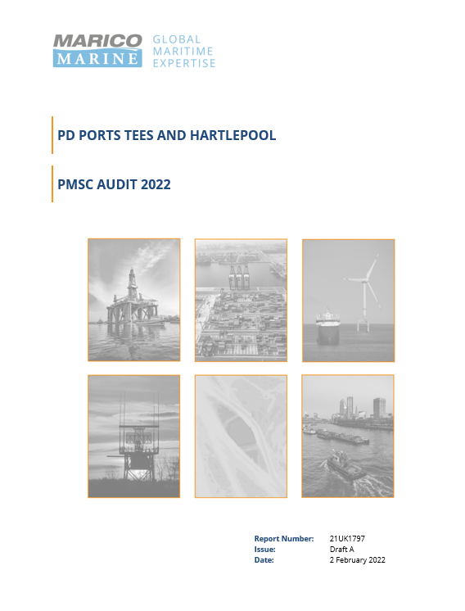
Designated person ‘Base Line / Internal Audit’ 2022
The majority of the available time during the audit was devoted to reviewing procedures in close to real time
A vessel visit was selected for review and using published procedures, the process of the vessel arrival from initial agent booking through to berthing was tracked, with the final berthing manoeuvre witnessed.
This approach provided the DP with a excellent opportunity to witness port marine activities at first hand and to be a assured that procedures are both generally effective, followed and suitably recorded.
PD Teesport Procedures and documentation found to be in good order.
As a result of this introductory visit and baseline audit, no non-conformities with the PMSC or related legislation were identified.

Slide 10
Marine safety management system (msms)
SHA’s should operate an effective management system which has been developed after consultation, is based on formal risk assessment and refers to an appropriate approach to incident investigation.
Key elements of a good MSMS require;
Effective safety policies setting a clear direction for the organisation to follow
Effective management, structure & resources in place to deliver the policies
Implementing safety polices through a risk based management system
Measuring performance through review & audit against standards and improve where needed
Implement incident investigation, reporting & review and apply any actions for improvement identified to safe working practices.

Slide 11
Audit
There is a requirement to monitor, review and audit the marine safety management system and risk assessment process on a regular basis. NRA Consultation with Port Stakeholders
Continuous (live) monitoring of operational procedures and safety performance
Regular review of marine operations and safety management
Annual internal audit of the MSMS / PMSC code procedures & performance
External audit to be undertaken every three years – Next External Audit 15th July 2022
Regulation consultation with Harbour Users & stakeholders
The Designated Person should present any audit report to the Duty Holder as part of the auditing & review process.

Slide 12
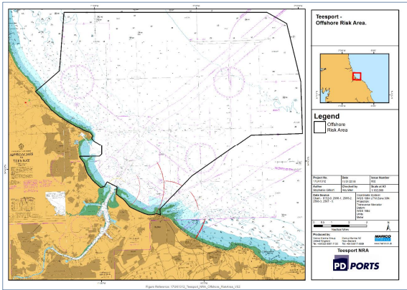
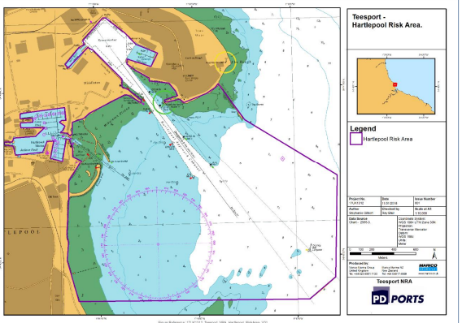
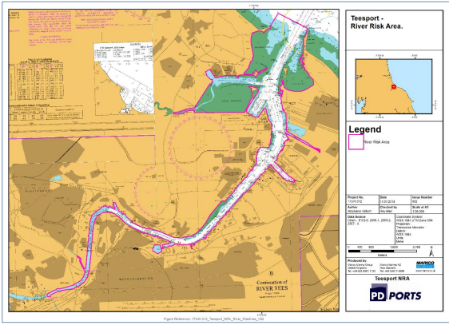
Navigational Risk Assessment

Slide 13
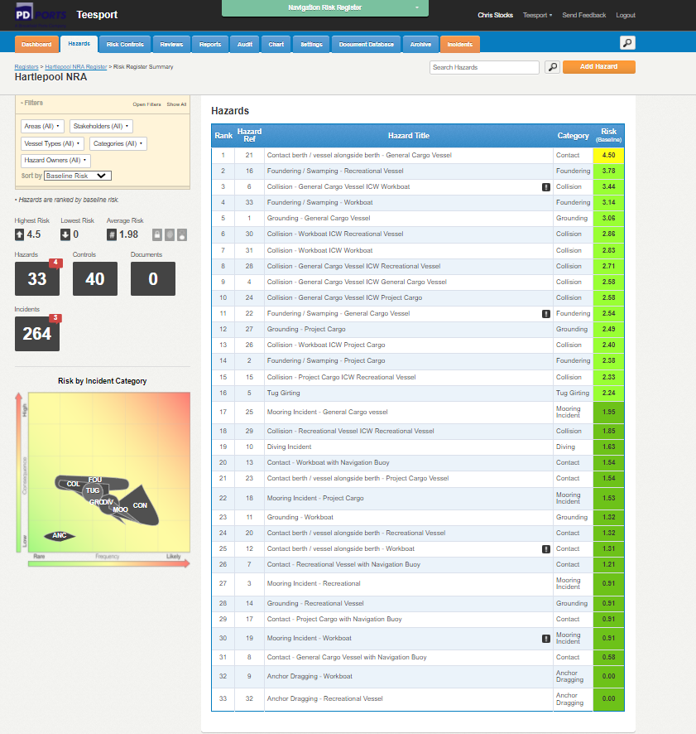
Navigational Risk Assessment
Number of Hazards Identified
Offshore - 63
River - 50
Hartlepool - 33
Number of Control Measures Identified
Offshore - 39
River - 39
Hartlepool - 40
Incident Investigation
Review Period
Stakeholder Consultation

Slide 14
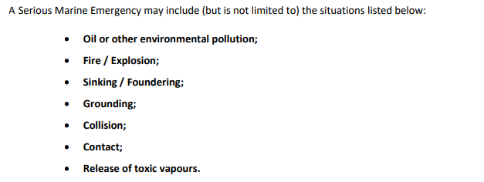
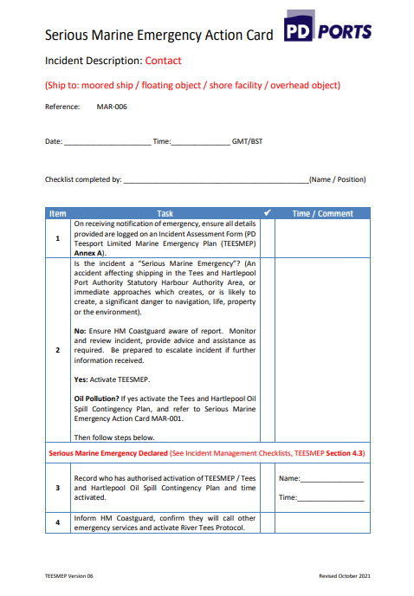
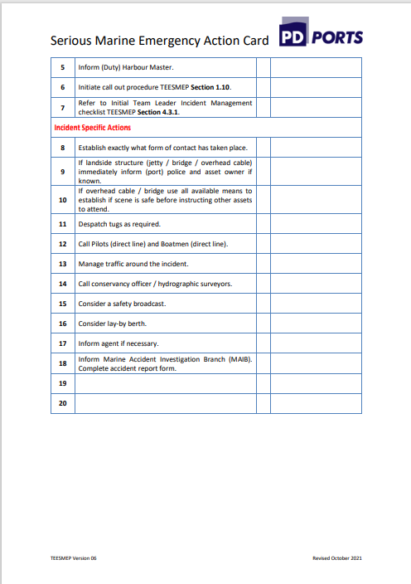
Marine Emergency Plan (Tees MEP)
TEESMEP is primarily designed to manage marine emergencies occurring within the PD Teesport Limited SHA

Slide 15
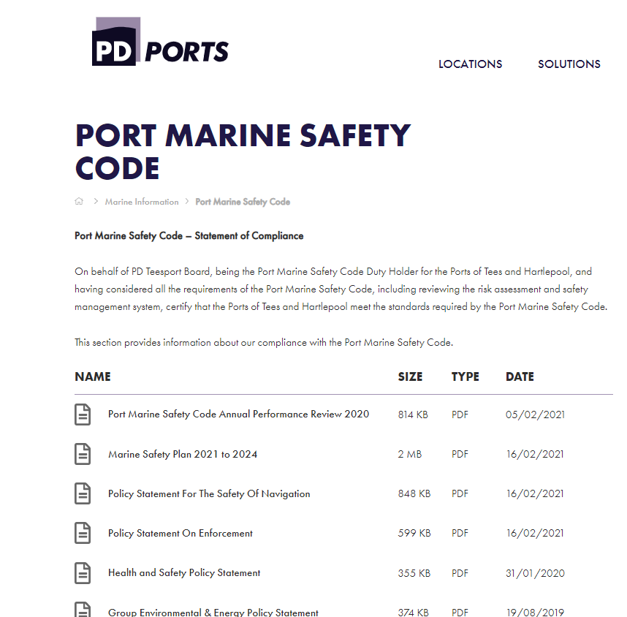
PMSC Documentation
More Information PD Ports Website:-Port Marine Safety Code - PD Ports
PMSC Annual Performance Report -2021
What does it cover? (10 commandments – annual performance against defined targets)
Legislation, Duties and Powers
Risk Assessment
Vessel Activity - MSMS
Incident Reporting
Audit and Reviewing
Competence
Marine Safety Plan – sets out ongoing standard and period performance targets
Aids to Navigation
Duty Holder
Designated Person

Slide 16
Questions

