Slide 2
About Bulk Tainer Group
The Bulk Tainer Group is a privately owned business established in 2009
No investors involved; from day one, all profits accrued have been reinvested back into the business year on year
Personnel / Assets / Systems / BTL Global Expansion / GPS Project
The Bulk Tainer Group now incorporates the following Divisions:
Isotank Logistics / Transport / Depots / Telematics & Customs Brokerage
Our number one target is to be one of the best in our business global sector

Slide 3
Bulk Tainer Group
Customs Broker Service
Isotank Shipments
Isotank Trucking &
Road Tanks
Depot, M&R, Heating
GPS System

Slide 4
Bulk Tainer Group – Company Goals And Values
Be one of the best isotank logistics company in our global sector
Continue to create a well motivated, experienced, dedicated and happy team of staff throughout the company
Become a vital part of our customer’s success
Work closely and fairly with our suppliers
As much as possible, enjoy the journey we are on together

Slide 5
Bulk Tainer Group - Assets
People
The Bulk Tainer team are the single most important asset to our success.
We currently employ 280 people
Our primary goal is to continue to grow a first class team of logistics personnel, who are determined, knowledgeable and proud to be part of the Bulk Tainer team within every department, every office and every region we operate across the globe
Positive customer feedback and growth demonstrates the service excellence and commitment this team brings

Slide 6
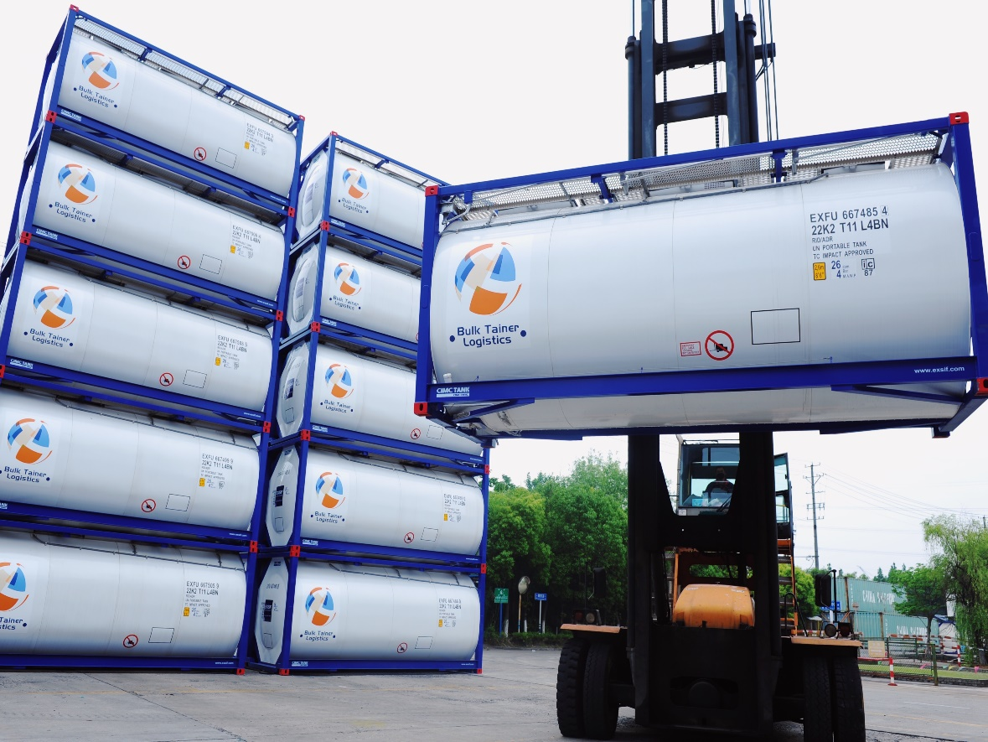
Bulk
Bulk Tainer Logistics - Assets Fleet details
Current Fleet size 9000 containers
BTL continues growing its fleet in a controllable way with a target fleet size of 12,000 containers
DS Fleet mainly ranges from 25,000 to 26,000 ltr tanks, with 50% baffled
SS Fleet ranges from 25,000 & 26,000 ltr 20fts and a swap-body fleet from 31,000 to 35,000 ltr with 50% baffled
All swap-body tanks and a proportion of 20ft tanks have ground operated vent lines

Slide 7
Bulk Tainer Logistics – Assets
Systems
Bulk Tainer bespoke Tank Planning System
Electronic invoicing
Secure tracking
B to B connectivity
Customer access
No client software required
GPS project integrating directly to planning system

Slide 8
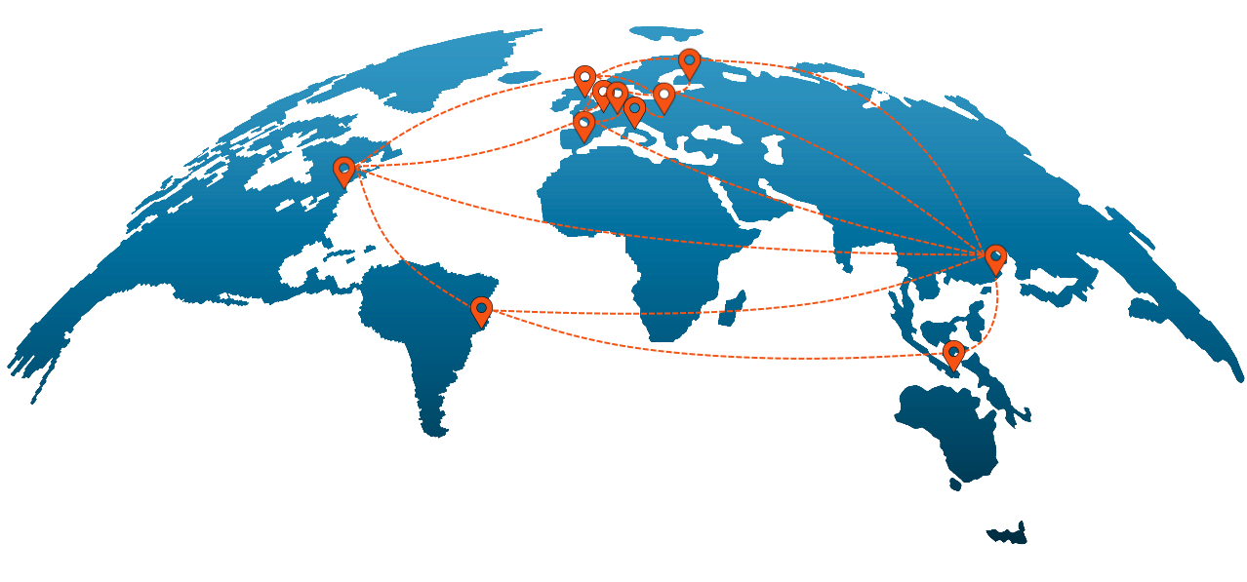
Bulk Tainer Logistics – BTL OFFICES & MARKET COVERAGE
Bulk Tainer Offices:
UK (Head Office)
Belgium Norway
Poland France
Spain Dubai
Italy China
Finland Singapore
Sweden United States
Operating across all regions:
North / South / East Europe
Mediterranean Region
Baltic Region
Middle East / India
Asia Pacific
North America
LATAM

Slide 9
.

Slide 10
Bulk Tainer Logistics – Building Partnerships
BTL work very hard to build true partnerships with our customers
BTL look to understand our customer’s business, its ethos, drives and strengths
We ensure our customers understand BTL and the logistics chain involved
Regular customer meetings create invaluable and trusting work bonds
Working together to provide our customer and our customer’s customer an excellent bespoke, value for money logistics model

Slide 11
Bulk Tainer Telematics - Company
Bulk Tainer created Bulk Tainer Telematics to guarantee that we created a bespoke telematics device totally designed to meet the demands & compliance of global isotank shipments
All features of the device consider the needs and demands of isotank operators and its customers:
Physical presence of the isotank
Product information
Product Stewardship
SAFE RELIABLE CERTIFIED

Slide 12
Bulk Tainer Telematics – KEY FEATURES
In house design
ATEX / Hazloc certification
Zone 1 Ex db ib (ia) IIC T4
Sustainable (low power / solar panel)
Global coverage
High performance
Sensors Product temp. Inlet temp. Ambient temp.
System integration Product Info Route Info
Smart updates Exception management
Notifications
Cloud based API enabled
GPS Geofence aware

Slide 13
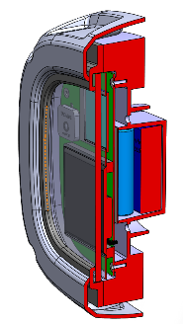
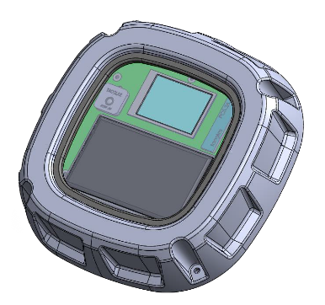
Bulk Tainer Telematics - System Integration
Key to this development is the direct connection to the Bulk Tainer planning system with initial planned benefits:
System / BTL order individually dictates operational use of GPS / data usage per trip
Location updates of tank position / linked to expected routings / dates / times from
BTL system
Above allows Exception Management by Bulk Tainer staff
Advanced time delay alerts are set against system set arrival times
Product and Ambient Temperature updates and high/low alerts
Water / steam inlet temperature checks and high / low alerts
Accurate customer status reporting
The GPS unit linking direct to our planning system will revolutionise how we interact with our equipment and speed of information to BTL and our customers.

Slide 14
Bulk Tainer Transport – Intermodal
Bulk Tainer Transport division created in 2018 which covers isotank & road tanker trucking
BTT UK – 21 Trucks based across Hull, Immingham, Liverpool, Birmingham & Goole
BTT NL – 10 Trucks, depot South Rotterdam
BTT Spain – 18 Trucks, based in Valencia & Barcelona
Additional trucks on order across all above locations plus a trucking company acquisition opportunity in China

Slide 15
Bulk Tainer Transport – Domestic Road Barrel
Bulk Tainer Transport acquired UK domestic road barrel company in 2020.
This adds a further solution to offer our customer base in particular with Brexit in mind
BTT Domestic – 5 Trucks, depot Huddersfield
BTT Domestic – 6 Road barrels
Additional trucks and road tankers are on order

Slide 16
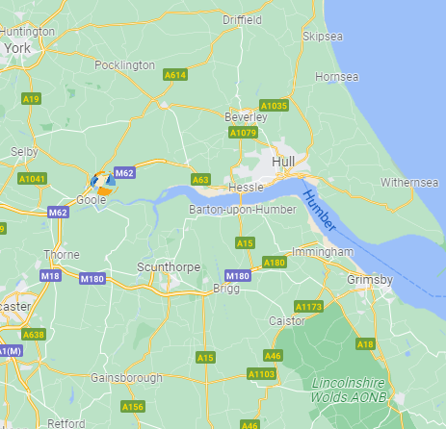
Bulk Tainer Depots – Goole
UK
New Depot – Goole opens Q3 2022
The depot will offer the following services:
Empty lifting and storage
Heating – Steam / Warm Water / Electric
Tank Workshop for repairs, pressure testing and in the future periodic testing
Trailer Workshop
Bulk Tainer Depot Valencia will look to offer similar services as above later in 2022 / 23
Preliminary plans and land identified in both Rotterdam and Houston, with further expansion across the US East coast through 23, 24
Duisburg region now also on radar

Slide 17
Bulk Tainer Customs Brokers
BTCB was established to meet Brexit demands linked to Bulk Tainer Logistics current customer base
Through our reactive response to the challenges of Brexit we gained many additional customers and now successfully provide our Broker Services to many independent businesses
We look to understand our customers’ business needs and requirements to build our services around to ensure efficiency and quality standard of our services providing bespoke approach

Slide 18
We operate in UK covering majority of UK port locations & providing below services:
Maritime & Road port clearances (import / export) & EXS for empties
Duty Deferment
ETSF & Customs Warehouse clearances
GVMS Border Cross / GMR
EUR1 & Certificates of Origin
Customs consultancy

Slide 19
Bulk Tainer – In Summary
Maintain high standards of customer service through our safety and quality focused culture
Continue to develop our bespoke ERP and GPS project across our whole fleet
Continuous isotank new build programme in line with current and future customer demands
Grow and support Bulk Tainer division’s to suit customer needs
Invest in key hubs to provide a secure and consistent service to our key customers
Become a vital component of our customer’s success

