Slide 1
Harbour police
Presentation to THPUA.
Wednesday 13th July 2022

Slide 2
https://player.vimeo.com/video/692239826?h=769118c156

Slide 3
History and legislation.
Established on 18th January 1904 under the Harbour, Docks and Piers Clauses Act 1847.
Powers of a Harbour Police Constable derive from the Tees and Hartlepool Port Authority Act 1966.
Jurisdiction area 2 miles beyond the high water mark, from the Tees estuary to the barrage at Stockton on Tees.
Sec 7(2) Marine Navigation Act 2013 extends Harbour Police officers powers beyond the jurisdiction with approval of the Chief Constable for that area under certain conditions.

Slide 4
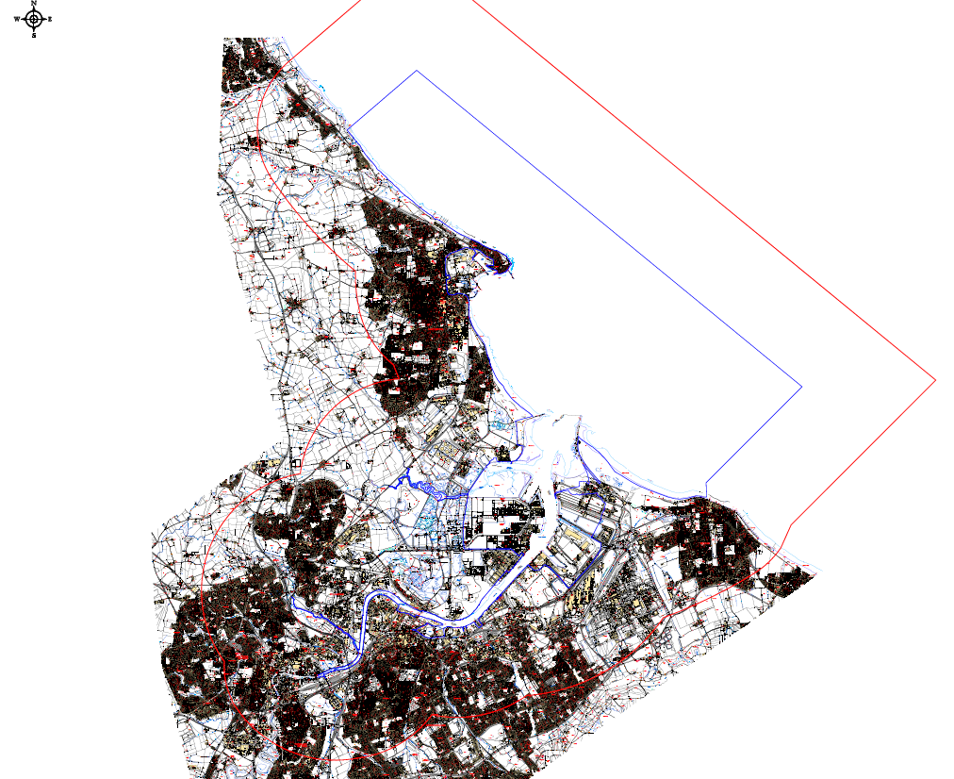
Jurisdiction area

Slide 5
structure
MICK JACKSON
HARBOUR POLICE
CHIEF OFFICER
A RELIEF
SGT STEVE COULSON
PC KATH SYKES
PC MARK BAINES
PC MIKE MARR
PC GAVIN ALCORN
B RELIEF
SGT TIM WOOLVEN
PC TOM TAYLOR
PC JASON BARTLETT
PC MARK PEARSON
PC RICHY BAILEY
C RELIEF
SGT MATT SMITH
PC DEAN ROBINSON
PC RICK LOVICK
PC ADE BERRYMAN
PC JOHN GRAHAM
SGT PAUL HUSBAND
OPERATIONS SUPPORT
D RELIEF
SGT IAN CRAIG
PC MARK SAVAGE
PC PAUL COWLING
PC MICK JOHNSON
PC JONATHAN WRIGLEY
NEAL ARMSTRONG
HEAD OF POLICE,
SECURITY AND RESILIENCE

Slide 6
PARTNERS
NERSOU
NaVCIS
IFCA
LRF/EPU
NEAS HART
PD PORTS
BTP
GLAA
TENANTS
CFB
BORDER FORCE
NCA
HARBOUR MASTERS OFFICE
CLEVELANDPOLICE
ENVIRONMENT AGENCY
SECURITY
&
CCTV
CNC
DVSA
LOCAL
AUTHORITY
TRADING STANDARDS
CTSA’S
NMIC

Slide 7
Operational performance
Safety.
Process.
Standards.
Proactive/Prevention Operations.
LRF Exercises.
Examples.

Slide 8
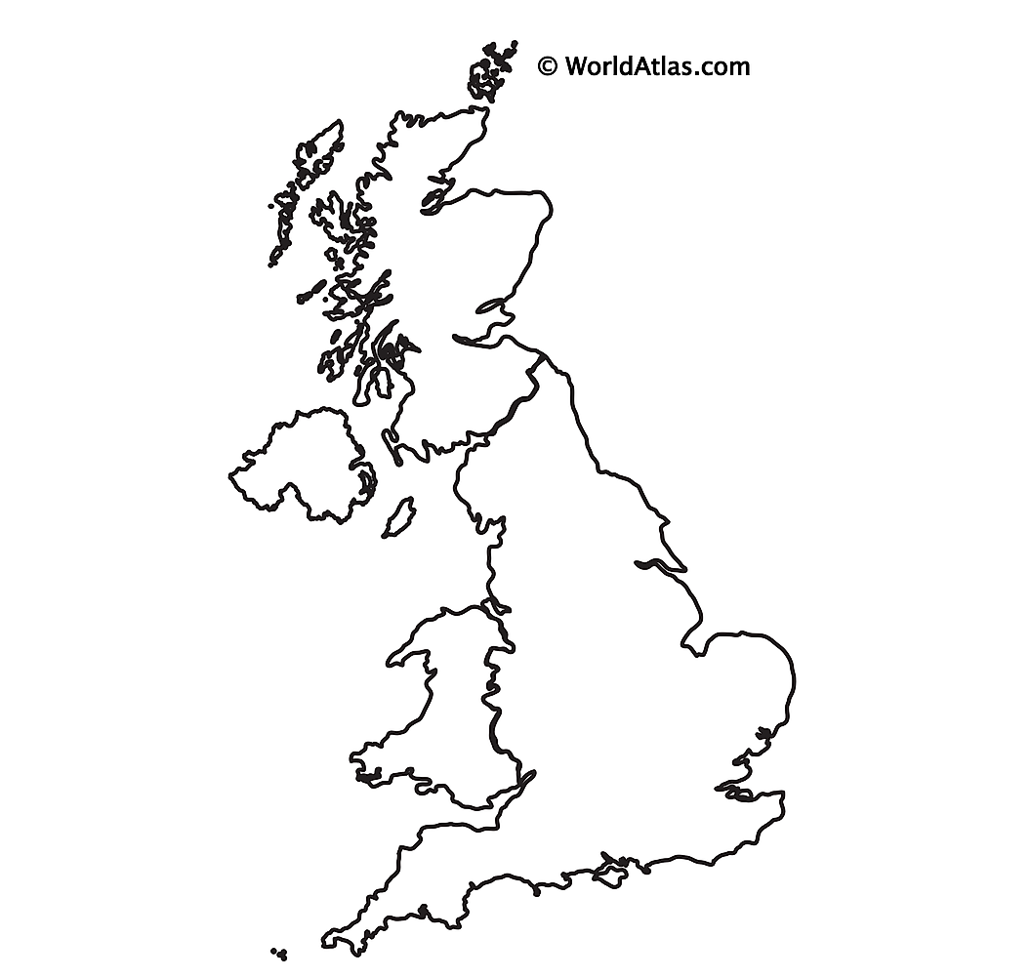
Benchmarking.
Benefits to Port Authorities.
Commercial and operational benefit of having a dedicated policing service where local policing is in high demand.
Crime prevention, deterrence, emergency and crisis response.
Investigation, detection and prosecution of offences committed within the Port Authority area.
Safety reassurance, compliance and enforcement.
“Blue Light” services incident response coordination.
Multi Agency point of contact.
Intelligence gathering – missing jigsaw piece.
Enforce ISPS code and local byelaws.
Traffic Management and abnormal loads escorts.
BELFAST.
.TEESPORT AND HARTLEPOOL
TEESPORT
LIVERPOOL.
.FELIXSTOWE
TILBURY.
.BRISTOL
.DOVER
.
PORTLAND

Slide 9
Community/stakeholder engagement.
Community Policing Plan
Introduced February 2020
Approx 60 locations.
R.A.G.

Slide 10
Community/stakeholder engagement.
feedback
“Having a designated Police Officer from Harbour Police as our point of contact for the Community Policing Plan allows us to have someone who is aware of our local area and relevant issues on our doorstep. We can report anything at all to any Harbour Police officer, but PC Pearson will always follow up on our concerns and provides us with updates and outcomes which is important to us. The increased presence of a Police Officer in and around our building is appreciated and adds another level of deterrence to unwanted visitors at anytime time day or night”
Luke Oldham, VTS Manager, Harbour Office.
“Insurers take comfort in us having the Harbour Police over and above the standard security provision at other ports and terminals that they deal with and whilst there is not a measurable pound for pound saving in the insurance premiums that we pay it does make us more insurable, thus creating competition in the insurance markets that we deal with, the knock-on effect being better premiums”
Caroline Carsley, PD Ports Group Insurance Manager.
“I would like to express on behalf of LV Shipping Ltd our thanks and appreciation of the site security and its important role here at Teesside Commerce Park. There is nothing worse than coming to work to find that customer goods or our own plant and equipment have been stolen. The recent improvements to the security gate entrance and the regular patrols carried out by Harbour Police in and around our offices have had a really positive effect and in many ways have reduced incidents we have had in the past. Its always a pleasure to see PC Paul Cowling who is a regular visitor and he keeps us informed of recent events and how we can continue to improve on our own security arrangements”
Garry Burnip, Branch Manager LV Logistics.

Slide 11
Community/stakeholder engagement
feedback
“The relationship we have developed with Harbour Police since having an assigned officer has been particularly valuable in Unitised. We have been supported with operational and health and safety issues, especially with speed reduction campaigns. The main benefit though has been the ability to reduce impact and disruption on our customer service and port users when government agencies and other emergency services need to interact with the terminal. A recent example where this relationship was useful was when Border Force were required to examine a large number of containers of interest. Due to the trust and appreciation of one another’s requirements we were able to facilitate the operation without any issue, and these positive interactions will only enhance our cooperation in the future.
An assigned officer knows our business and some of the challenges that we face, such as characters and practices we occasionally encounter in the Africa Ro-Ro or the need for security of high value freight such as luxury cars. Even if only calling for a coffee, that presence provides a level of assurance to staff and visitors that we take security and safety of our site seriously”
Mike King, Operations Manager, Unitised.
“The benefits of having a Harbour Police for us is two fold, we are able to build relationships and trust with a number of our key members of staff who know they have a person to go to for advice and support when needed. Secondly and most import for me is that Harbour Police are a crime deterrent, nobody knows when they will visit and walk the site with myself or other security officers and this reduces the risk of theft of Tesco property.”
Ken Lowes, Tesco Distribution Centre Security Manager.

Slide 12
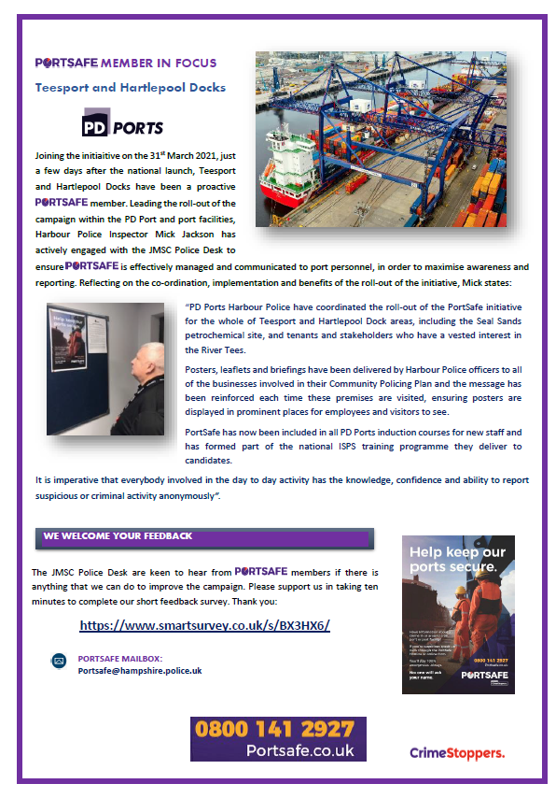

Slide 13
contact
In an Emergency call 999.
24/7 Harbour Police – 01642 277216
Sgt Paul Husband (Ops Support) – 01642 277215 paul.husband@pdports.co.uk
CO Mick Jackson – 01642 309805 mick.jackson@pdports.co.uk

Slide 14
Thank you.

