Slide 1
Port Community System
Chris Stocks

Slide 2
Agenda
About Port Insider Pre-Arrival Notification Timeline Visit View AIS Map Hydrometeo Notifications Waste Management

Slide 3
About Port Insider
What is it? – Award winning online platform for stakeholders and river users
When did it launch? July 2021
Why did we create it? For the community to have better insight of visits

Slide 4
Pre-Arrival Notification
Notice to Mariners No.14 Create & Manage Visits Document Storage & Historic data

Slide 5
Visit View & Timeline
View documents associated with visit View completed & planned movements View movement information such as location details, draught & services

Slide 6
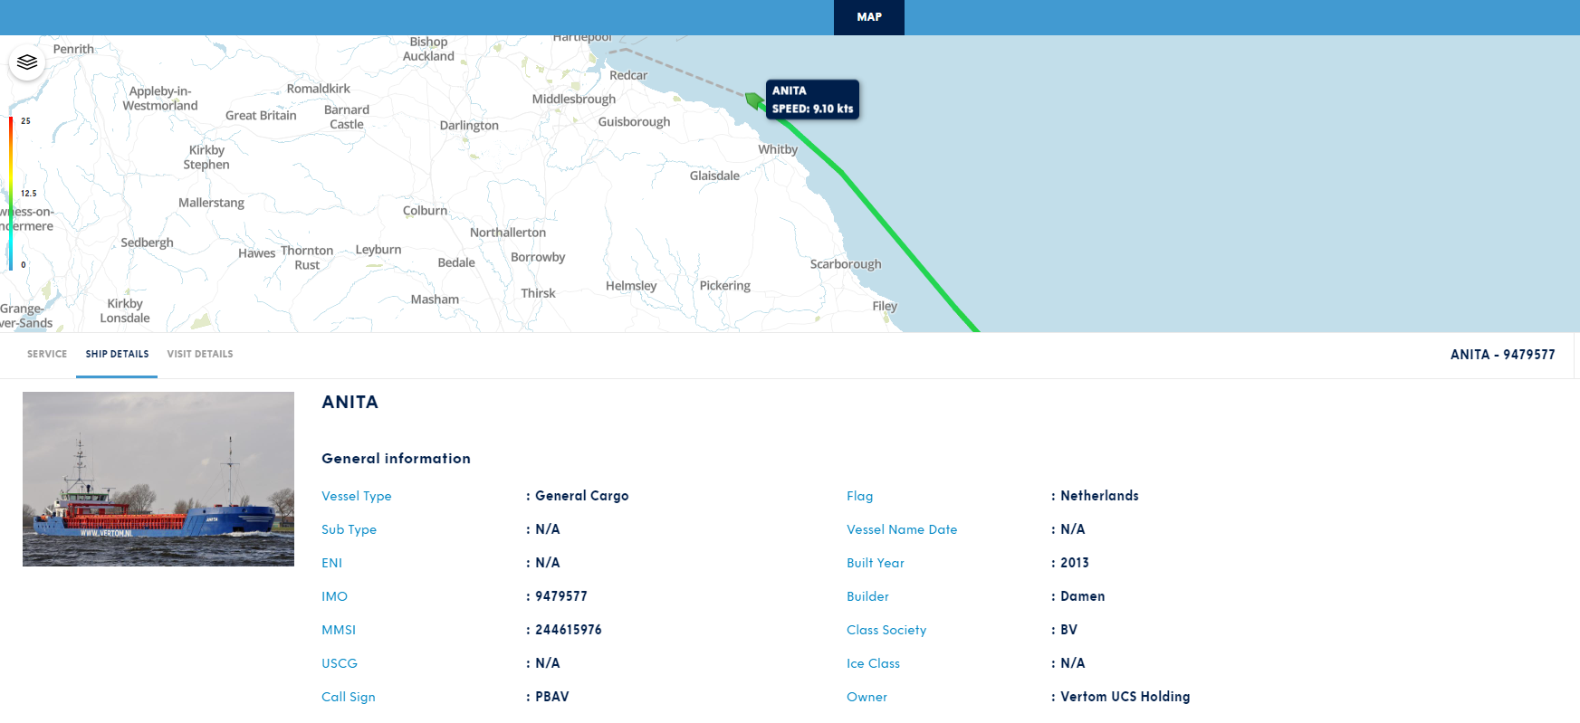
AIS Map
Live AIS data
Track vessels direct from Port Insider

Slide 7
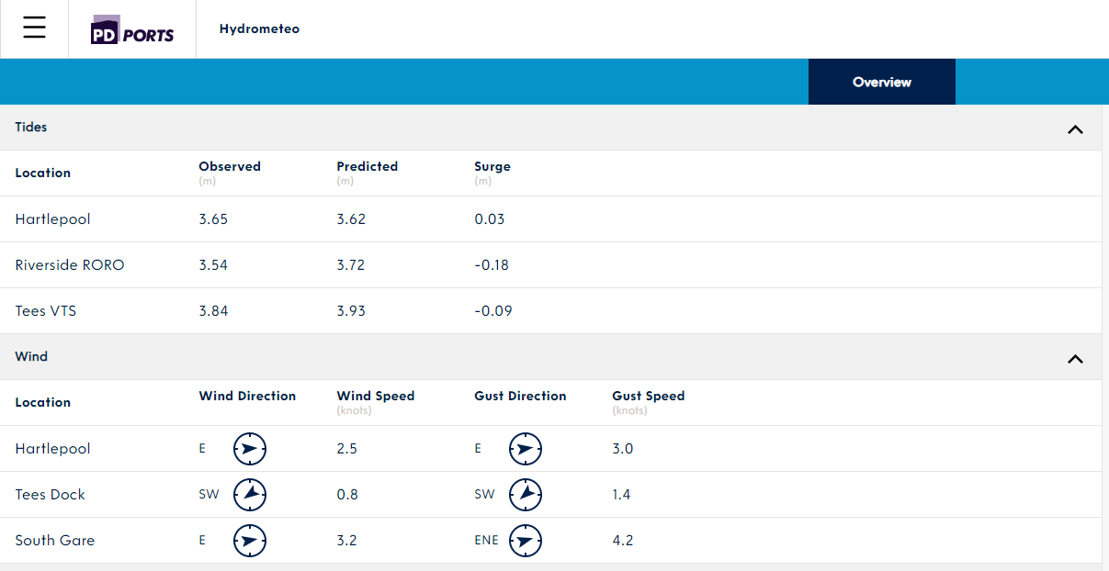
Hydrometeo
Live met data direct from PD weather sensors

Slide 8
Notifications
Tailored notifications for your associated visit.
Firm order Services added/removed Reporting line crossing Arrival / Departure times Detained vessel
Notifications from Harbour Master to replace mailing lists

Slide 9
Waste Management
PD Ports operate the waste management plan Importance of waste reporting Advanced planning means improved service

Slide 10
Questions?
Contacts Chris Stocks chris.stocks@pdports.co.uk
Luke Oldham luke.oldham@pdports.co.uk
Amy Previll amy.previll@pdports.co.uk

Slide 11
Port Marine Safety Code

Slide 13
.
Review and Audit: Monitor, review and audit the risk assessment and MSMS on a regular basis – the independent designated person has a key role in providing assurance for the duty holder.
Internal Audit Dates:- 21st February 2022
15th February 2023
Conduct by DP William Heaps Marico Marine. Internal Audits conducted Annually
External Audit Date:- 22nd July 2022
Conduct by Monty Smedley and Capt Martin Phipps MBE. External Audits conducted 3 yearly
Port of Tees and Hartlepool remain compliant with the requirements of Port Marine Safety Code

Slide 14
.
Internal Audit 15th February 2023
Focus Areas:-
Review of Action Tracker of previous audits. 33/41 actions complete.
VTS Manual / Operational Procedures
Mooring Procedures
Observing the procedures for safety mooring (unmooring of vessels) – Half Day.

Slide 15
.
Internal Audit 15th February 2023
Conclusion
Audit intended to identify
Previous recommendations were appropriate and had been formally integrated into the MSMS
Comprehensive procedures which audits has confirmed are in place are being followed during daily marine operations.
Both the above objectives have been met

Slide 16
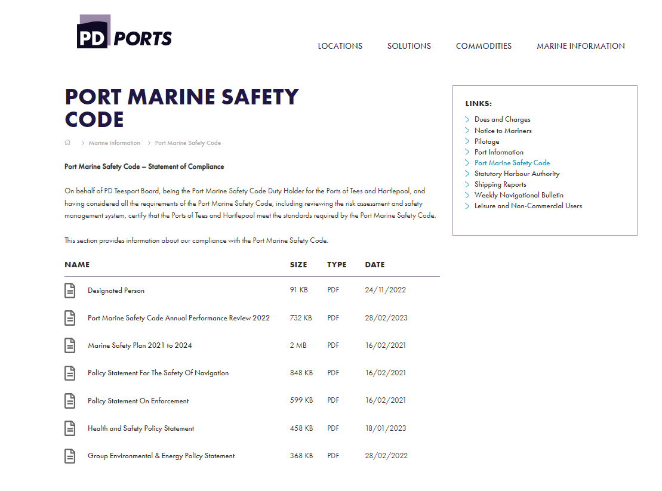

Slide 17
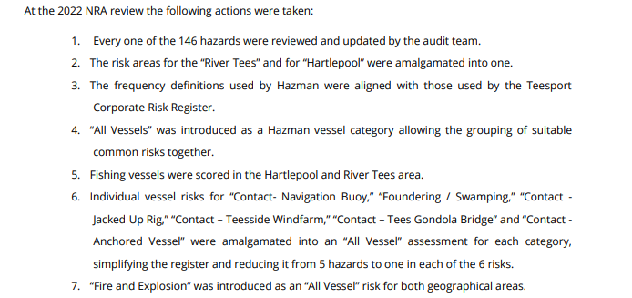
.
Navigation Risk Assessment Review 2022

