Slide 1
Survivors of Bereavement by Suicide
Teesside Branch

Slide 2
Who Are We?
Registered charity in England and Wales
Est.1991
Bereaved by Suicide
Volunteer Peer Support
Notes:
Survivors of Bereavement (SoBS) is a registered charity that was founded in 1991 - 16th April 2021 – will be our 30th anniversary: 30year 30mile campaign.
Alice Middleton MBE, who is now our founding patron.
Following the death of her brother and finding little support available, she placed an advert in her local paper seeking to make contact with others who had been bereaved by suicide.
She started the first support group from her living room in Hull
We have grown to become the only national charity providing dedicated peer support to adults who have been bereaved by suicide.

Slide 3
Who Are We?
Notes:
305 volunteers across the UK who help to run our services – and we continue to grow.
Our volunteers come from all walks of life but nearly all have been touched by suicide themselves, this experience enables them to connect with others.
Small national support team in our office in Ilkeston, Derbyshire who provide support to our volunteers and who manage our operations.
Our team of trustees meet regularly, providing leadership and governance to our charity.
We have 3 ambassadors for our organisation and they work to raise our profile and bring support to our organisation.

Slide 4
Our Services
National Support Line
Peer led, self-help Support Groups
Email Support
Online Forum
Conferences and Support Days

Slide 5
Support Services

Slide 6
Website

Slide 7
Social Media Following

Slide 8
Teesside SOBS
Teesside Branch started in January 2022 – based in Norton
Evolved from Suicide Grief Support Group which began in March 2019
Three facilitators
Myself
Natalie
Sally
Since starting the support group we have provided a safe space for around 100 people.

Slide 9
Teesside SOBS
For every person who dies by suicide at east 6 people are directly impacted and usually many more.
Ripple effect – can impact over 100 people
Minimum of 1500 people in the North East without Support
North East has the highest rate of suicide of any other region in the UK with 14.1 deaths by suicide per 100,000 people.
Those who have lost through suicide are 1.6 times more likely to have suicidal thoughts, 2.9 times more likely to have a plan for suicide, and 3.7 times more likely to have made a suicide attempt themselves.

Slide 10
Teesside SOBS
Questions….. So many questions…
When Why Who Where
What Next Was it me Was it her
Was it him Should be different

Slide 11
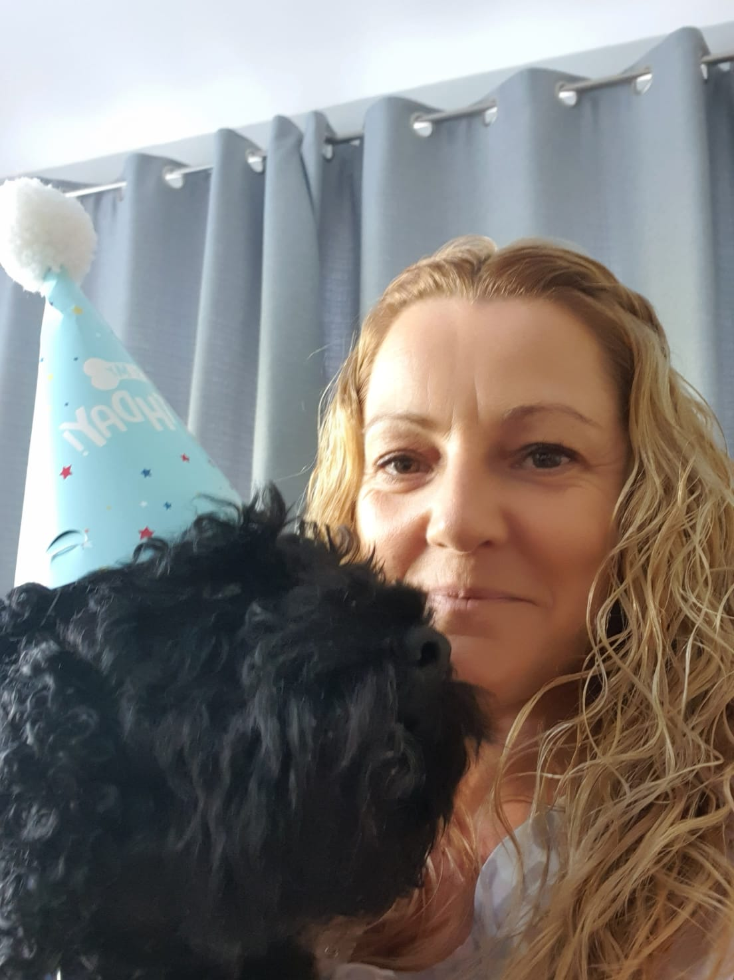
Teesside SOBS
Born in Darlington and has worked for Durham Constabulary as a police officer for 17 years.
7 years ago Natalie lost her father to suicide. This was unexpected and impacted her greatly. It was hard to process and Natalie found it difficult to discuss with other members of her family as not to raise concern.
Found SOBS and went to some group sessions however they were far away.
Found SGSG and attended group sessions. Once ready Natalie volunteered to be a SOBS facilitator to enhance the presence of SOBS in the region.
Natalie

Slide 12
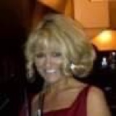
Teesside SOBS
Sally
Sally became involved with SOBS recently through work relationship with Michelle.
Sally lost a friend and colleague to suicide 10 years ago and wants to help raise awareness of suicide and help support the people who are left behind.

Slide 13
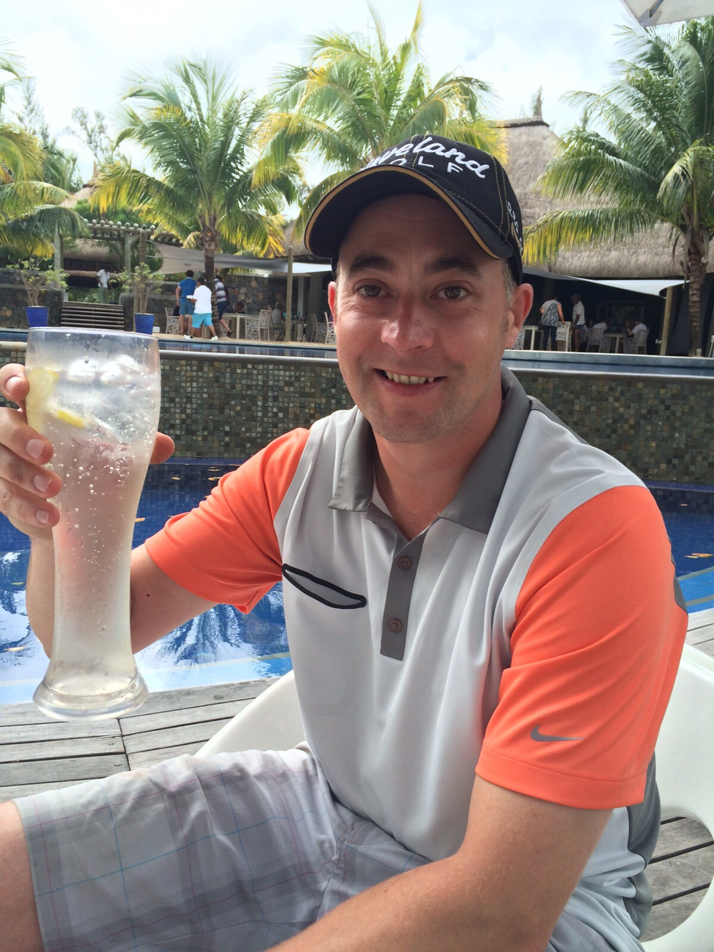
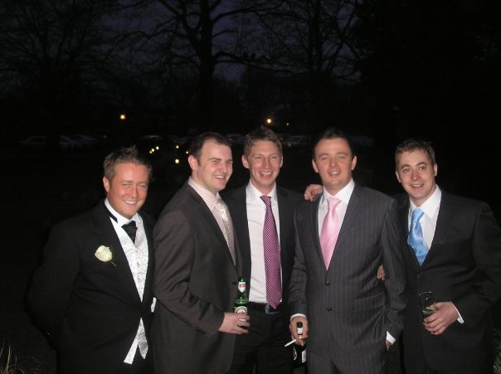
Teesside SOBS
Notes:
Survivors of Bereavement (SoBS) is a registered charity that was founded in 1991 - 16th April 2021 – will be our 30th anniversary: 30year 30mile campaign.
Alice Middleton MBE, who is now our founding patron.
Following the death of her brother and finding little support available, she placed an advert in her local paper seeking to make contact with others who had been bereaved by suicide.
She started the first support group from her living room in Hull
We have grown to become the only national charity providing dedicated peer support to adults who have been bereaved by suicide.

Slide 14
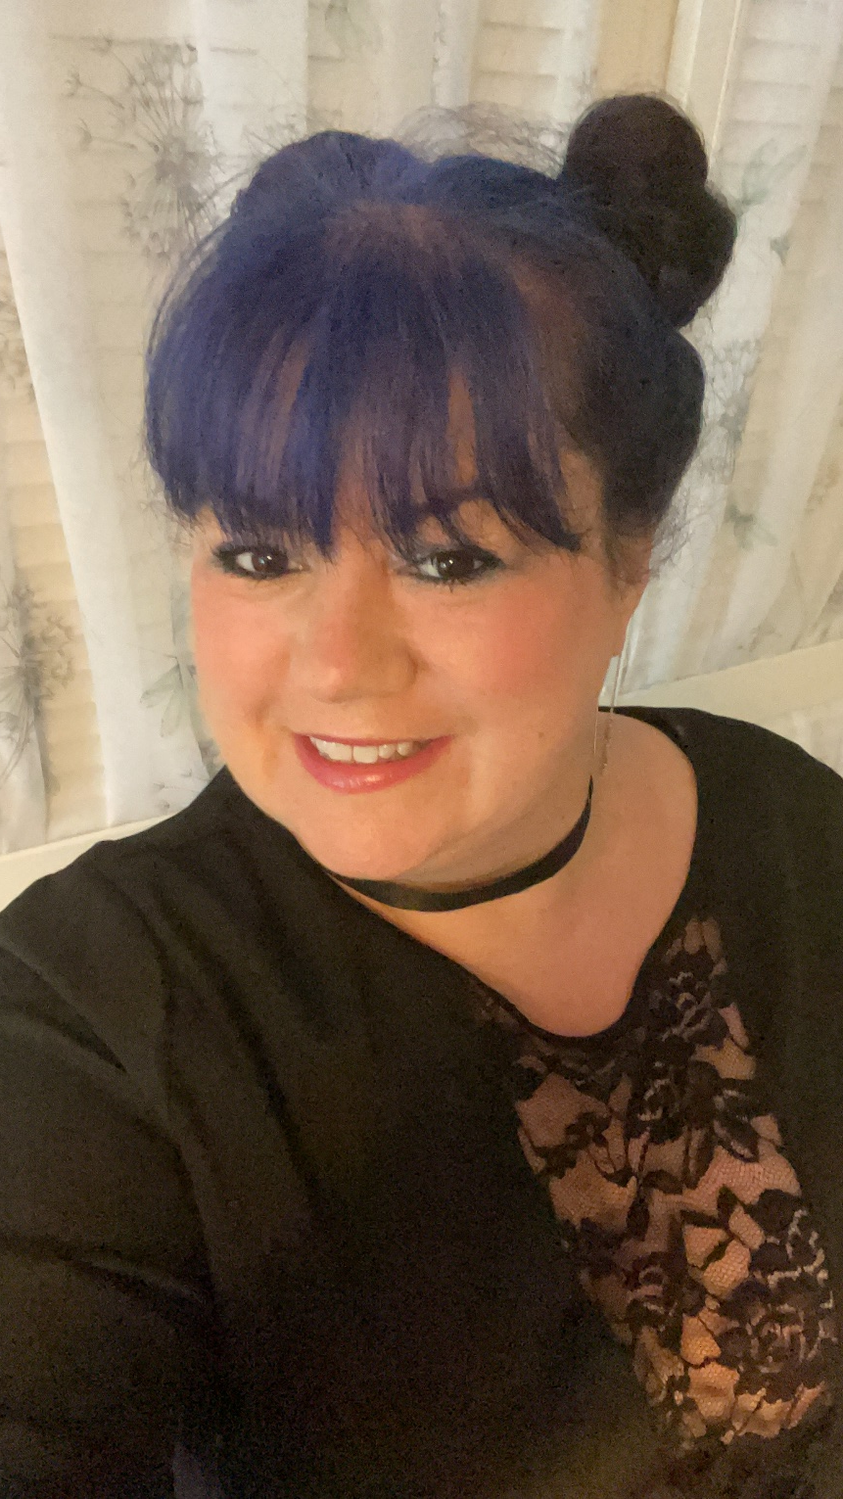
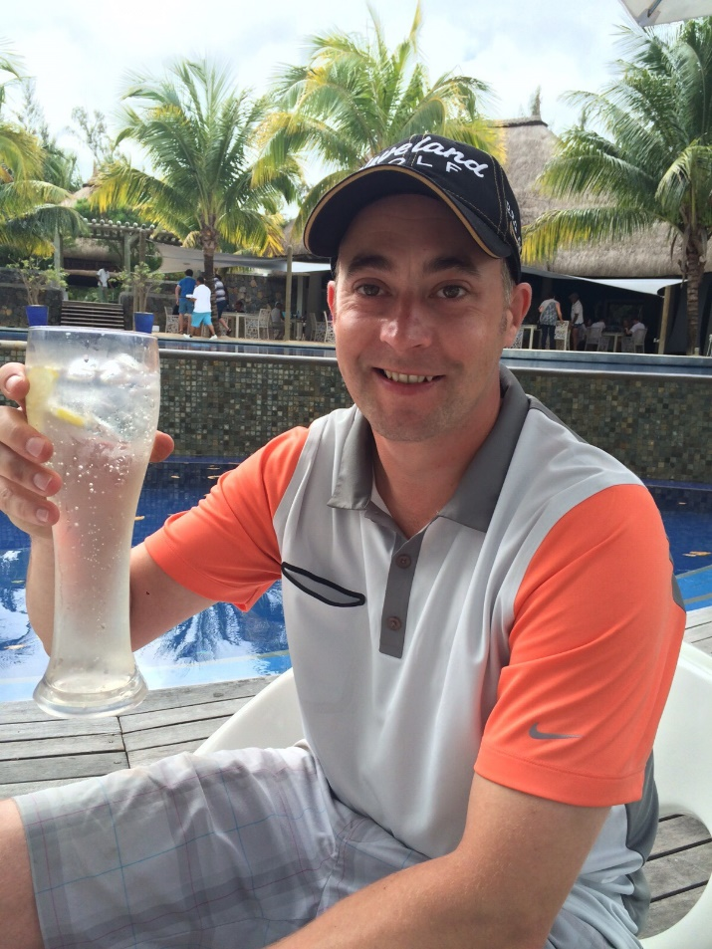
Teesside SOBS
Michelle
Michelle became driven to set up a support group in the North East after losing Peter in 2017. Unexpected – successful and outwardly happy man. Sociable, stable business, stable relationship.
No support for family or friends in the area.
Began with SGSG until facilitators came forwards.

Slide 15
Our Services
Email – write to email.support@uksobs.org
Support line – open 9am to 5pm Monday and Tuesday
0300 111 5065
bereaveMENt – email bereaveMENt@uksobs.org
Teesside SOBS – 07399 593910 Teesside@uksobs.org

Slide 16
Our Services
National Zoom Support Groups
Many Groups now run Zoom Support sessions which are open to all in the UK.
eastbourne@uksobs.org 1st & 3rd Wednesday
scottishborders@uksobs.org 2nd Monday 10:30am-12:30pm
watford@uksobs.org 3rd Tuesday
bromsgrove@uksobs.org 3rd Tuesday
henley-on-thames@uksobs.org 4th Wednesday
aylesbury@uksobs.org 4th Thursday
edinburgh@uksobs.org Last Thursday of the month
‘

Slide 17
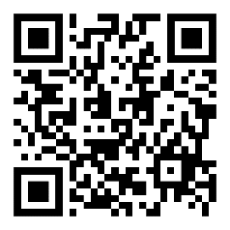
Our Resources
Help is at Hand
Support after Suicide
Leaflets
Cards
Videos
Poetry

Slide 18
Contact Details
Volunteer Coordinator (North)
Phill Abbiss
Phill.abbiss@uksobs.org
07535 854860
National Office
volunteering@uksobs.org
0115 944 1117

Slide 19
